Slide 1
NavEKF Change Overview 2020 “The State of the EKF”
Paul Riseborough
ArduPilot Dev Team

Slide 2
Change Overview
Merged Change Requests - 87
Enhancements – 74
Use World Magnetic Model for more robust mag fusion #11456
EKF2 terrain estimator use of optical flow #10539
Bug Fixes – 12
Open Change Requests - 17
Features – 3
EKF3 basic external nav system support # 10374
EKF2 sensor affinity control #11257
Operation with no or bad compass #13776
Enhancements - 14
Bug Fixes – 1

Slide 3
Change Overview
Noteworthy Bug Fixes
EKF2/3 compass switching #10461
EKF2 lane switch bug fix #11256
EKF2/3 slow mag bias learning after in-flight yaw reset #12221
EKF2/3 range finder RNG_USE_HGT use fix #12250
EKF3 Rover wheel encoder fixes #12578
EKF Fixed position error on GPS primary switch #13385

Slide 4
EKF2 vs EKF3
EKF2 is the default estimator
23 states
More robust to large angular alignment errors and performs well aligning on dynamic platforms.
Gets ‘dizzy’ if spun continuously at high rate around a vertical axis
Supports use of external nav system attitude and position data
EKF3 shares common math derivation with PX4/ecl
24 states
Estimates 3-axis IMU accelerometer bias -> Suitable for tail sitters
Doesn’t estimate gyro scale factor – not a limitation in practice
Can handle higher yaw spin rates.
Supports range measurements to static beacons, stereo VO, wheel encoders and external heading sensors (eg dual antenna RTK GPS).

Slide 5
Reducing Magnetometer Data Reliance
The EKF2 and EKF3 navigation estimators rely on being able to measure yaw to counteract inertial navigation gyro drift and to set the initial yaw angle. This is currently achieved using:
Magnetometer measurements – limited to operation away from magnetic poles and vulnerable to interference
Yaw from dual antenna RTK GPS – expensive HW and requires a higher SNR
GPS aiding – Requires regular horizontal velocity changes and initial yaw alignment. Can be used on planes by aligning yaw to GPS velocity vector on launch
Navigation errors due to bad magnetometer data account for the majority of loss of navigation events for installations that have solved vibration issues – See last years talk that included the effects of high vibration.

Slide 6
Improved Robustness to Magnetic Interference
Incorporate more prior knowledge of the earth magnetic field to reduce the effect of magnetometer calibration errors and vehicle based interference:
PR 11456 set a limit on the difference between the earth field from the WMM tables and the learned earth field inside the EKF2.
This is controlled by the EK2_MAG_EF_LIM parameter which is currently set to a default tolerance of +- 50mGauss
PR 12337 added the same functionality to EKF3
This is controlled by the EK3_MAG_EF_LIM parameter which is currently set to a default tolerance of +- 50mGauss

Slide 7
Yaw Alignment Using Only IMU and GPS
Preliminary algorithm work performed in 2018 to determine if it was possible to rapidly determine the yaw angle using only IMU and GPS Velocity data without relying on assumptions about the vehicle dynamics.
Investigation used simulated data and compared performance of different 3-state filter designs:
EKF (Extended Kalman Filter)
UKF (Unscented Kalman Filter)
EKF-GSF (Gaussian Sum Filter using states from multiple EKF’s)
UKF-GSF (Gaussian Sum Filter using states from multiple UKF’s)
EKF-IMM (Interacting Multiple Model Filter using states from multiple EKF’s)
UKF-IMM (Interacting Multiple Model Filter using states from multiple UKF’s)
Particle Filter
The GSF-EKF provided the best performance/computational cost trade-off for our application
Acknowledgement: Most of the matlab scripting for that study was contributed by Rudaba Khan
Notes:
d

Slide 8
EKF-GSF Yaw Estimator Description
The GSF-EKF algorithm consists of the following:
A bank of five AHRS solutions using a complementary filter
These calculate a predicted yaw angle and a forward, right acceleration.
Airspeed (measured or estimated) is used for centripetal acceleration correction during fixed wing flight.
A bank of five 3-state Extended Kalman Filters
States are North, East velocity and yaw angle
Yaw angle estimates start equally spaced
GPS North, East velocity is used as the observation
A Gaussian Sum Filter
Calculates a weighting for each EKF based on the normalized NE GPS velocity innovation levels.
Outputs a yaw angle estimate which is the weighted average of the individual EKF estimates.

Slide 9
EKF-GSF Yaw Estimator Block Diagram
yaw correction
yaw correction
yaw correction
yaw correction
yaw correction

Slide 10
EKF-GSF Yaw Estimator Progress
Support from multiple sponsors (Wingtra, Auterion, SYPAQ) enabled the algorithm development work to be taken to a 6DoF prototype in Matlab followed by separate coding for the PX4/ecl and ArduPilot AP_NavEKF libraries.
The feature is now merged into PX4/ecl master and will be part of the upcoming PX4 1.11 release
The feature has been submitted as a pull request to Ardupilot - https://github.com/ArduPilot/ardupilot/pull/13776
Both ArduPilot and PX4 projects have benefited from the parallel development due to lessons learned during development and testing.

Slide 11
EKF-GSF Yaw Estimator Testing
Flight testing to date has demonstrated:
Multicopter take-off in LOITER or AUTO mode with declination set to a value up to 180 degrees from truth (AP_NavEKF2/3 & PX4/ecl)
Navigation recovers and the flyaway stops before the EKF failsafe activates.
Multicopter take-off in a ALT_HOLD control mode with compass use inhibited (AP_NavEKF2/3 & PX4/ecl)
Navigation starts and LOITER can be selected a few seconds after takeoff with less than 4m of horizontal movement required.
Flights with a QuadPlane (AP_NavEKF3)
Demonstrated correct centripetal acceleration compensation and handling of RW -> FW -> RW transitions
Flights with a Wingtra TailSitter (PX4/ecl) set up with 180 degree compass error.
Navigation recovers and the flyaway stops before the failsafe activates.
CPU load increase measured on a STM32-F4 is <1% per NavEKF2/3 core

Slide 12
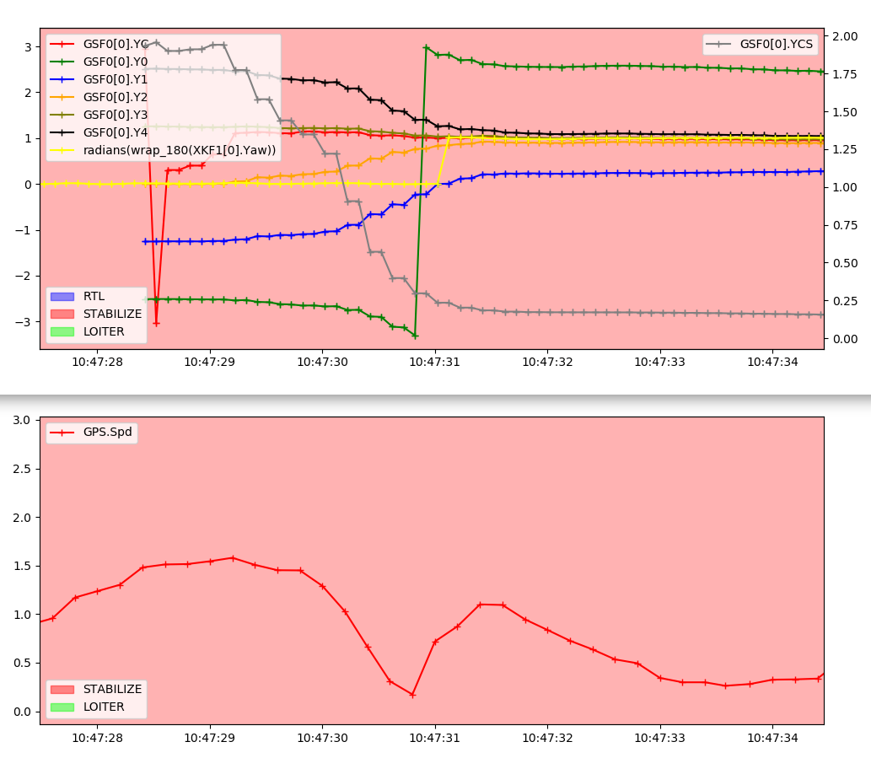
EKF-GSF Yaw Estimator Test Results
Intentional non-use of compass scenario:
Takeoff in STABILIZE with all COMPASS_USE = 0, and EK3_MAG_CAL = 6 (don’t use compass)
GSF0.YC (Red) is the GSF yaw estate in radians.
GSF0.YVS is the 1-sigma uncertainty in the GSF yaw estimate in radians
GSF0.Y0 … Y4 are the yaw estimates from the individual EKF’s
Yaw aligned within 3 seconds of takeoff following a slow horizontal position change performed at less than 1.5 m/s

Slide 13
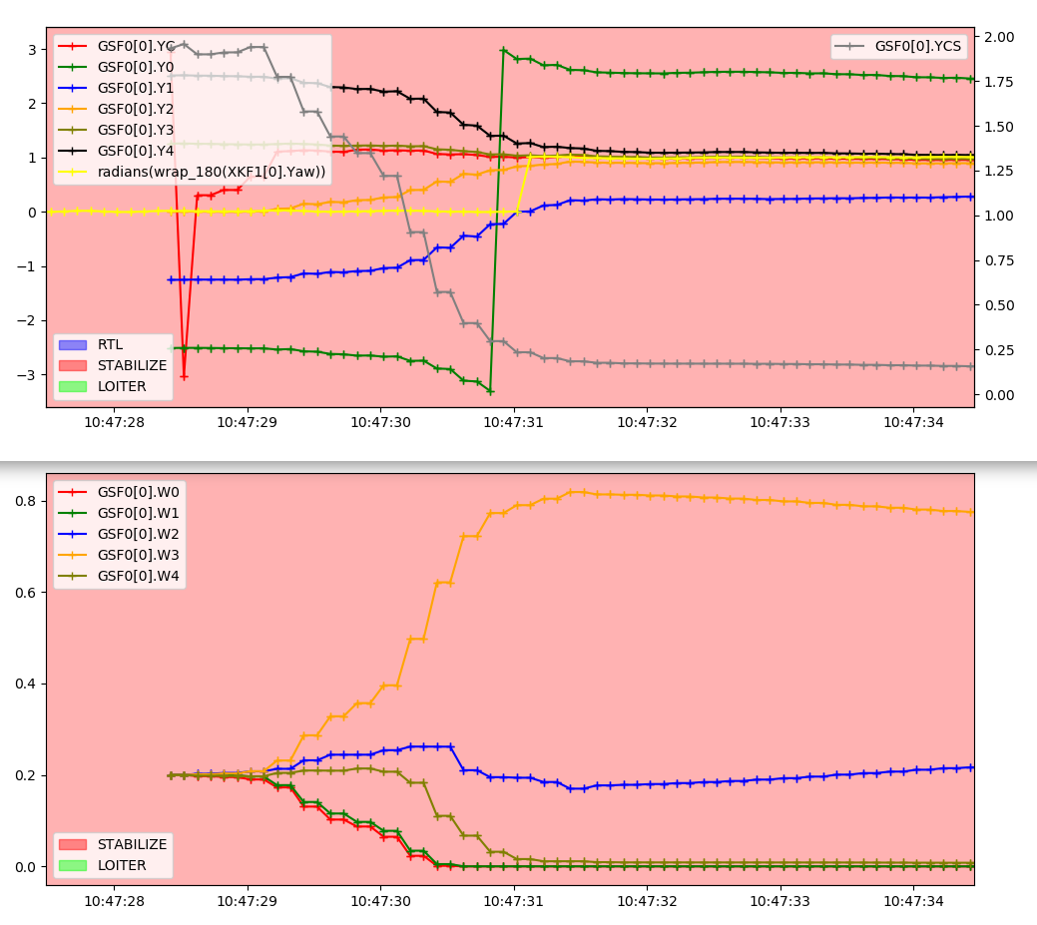
EKF-GSF Yaw Estimator Test Results
Intentional non-use of compass scenario:
Takeoff in STABILIZE with all COMPASS_USE = 0, and EK3_MAG_CAL = 6 (don’t use compass)
GSF0.YC (Red) is the GSF yaw estate in radians.
GSF0.YCS is the 1-sigma uncertainty in the GSF yaw estimate in radians
GSF0.Y0 … Y4 are the yaw estimates from the individual EKF’s
GSF0.W0 … W4 are the weightings that the GSF has applied when combining yaw estimates from the individual EKF’s.
The composite GSF yaw estimate GSF0.YC converges to the correct value before the individual filters do.

Slide 14
EKF-GSF Yaw Estimator Test Results
Flyaway scenario:
Takeoff in LOITER with COMPASS_AUTODEC = 0 and COMPASS_DEC = 3.0 to induce a 180 degree heading error on takeoff.
GSF0.YC (Red) is the GSF yaw estate in radians.
GSF0.YVS is the 1-sigma uncertainty in the GSF yaw estimate in radians
GSF0.Y0 … Y4 are the yaw estimates from the individual EKF’s

Slide 15
Discussion Points
EKF-GSF integration with existing lane switching and flight mode reversion and switching
Integration of vision based navigation
…

